Slide 1
BANK ANALYSIS REPORT

Slide 2
BANK ANALYSIS REPORT
Welcome to our Bank Loan Analytics Report - Leveraging Insights for Informed Lending Decisions
In today's dynamic financial landscape, harnessing the potential of data-driven approaches is no longer an option; it's a necessity. The world of banking and lending is evolving rapidly, and data analytics empowers us to make strategic decisions.

Slide 3
BANK ANALYSIS REPORT
Unveiling the Power of Bank Loan Analytics
Welcome to our presentation on Bank Loan Analytics - Unveiling Insights with Data Tools. In this journey, we will explore how the application of data-driven approaches, bolstered by tools like Excel, Power BI, SQL, and Tableau, can revolutionize our understanding of critical loan-related Key Performance Indicators (KPIs).

Slide 4
BANK ANALYSIS REPORT
Turning Data into Strategic Advantages
Bank loan analytics enables us to transform raw information into actionable knowledge. It provides us with the clarity needed to optimize lending strategies, reduce risk, and enhance customer experiences. With this report, we aim to empower with the tools and insights necessary to make strategic lending decisions.

Slide 5
BANK ANALYSIS REPORT
Aligning Strategy with Success
The true power of this project lies in its ability to shape our lending strategies while ensuring the financial well-being. By delving into the data and analytics presented within these pages, we embark on a journey to strengthen our lending operations.

Slide 6
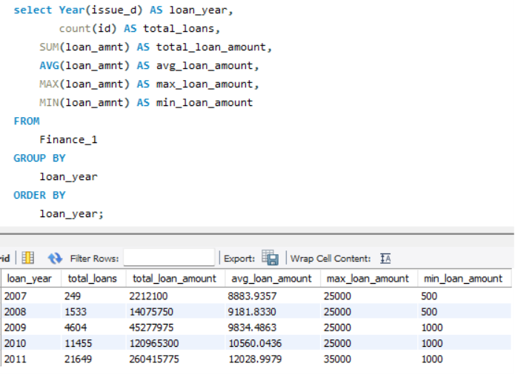
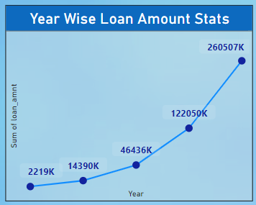
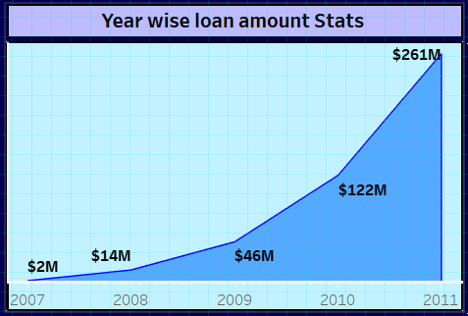
KPI 1 [Year wise Loan Amount]

Slide 7
KPI 1 ANALYSIS
As we have seen in the graph, There is a clear upward trend in the loan amounts over the years. This could indicate increasing borrowing needs or expanding business operations.
Growth Rate Analysis:
The growth rates of the loan amounts are as follows:
2008: 549.12%
2009: 223.52%
2010: 162.32%
2011: 113.35%
These growth rates highlight substantial increases in loan amounts from year to year, indicating strong business activity.

Slide 8
IMPROVEMENT POINTS
Need to analyse, why the loan amount increased during these years. Were there economic factors, policy changes, or industry trends that contributed to this growth?
It will also helpful to add some new schemes by anylyse the purpose of loan taken by borrowers, like Were they for expansion, new projects, operational needs, or something else?
Explore new markets or geographical areas where there is a demand for loans. Expanding your reach can lead to higher growth opportunities.
Collaborate with other financial institutions or fintech companies to offer innovative loan products. Partnerships can open up new avenues for growth.
Gather feedback from existing customers to identify areas of improvement. Positive word-of-mouth and customer referrals can contribute to growth.

Slide 9
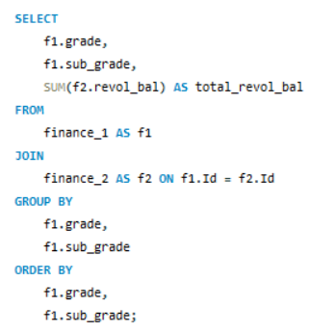
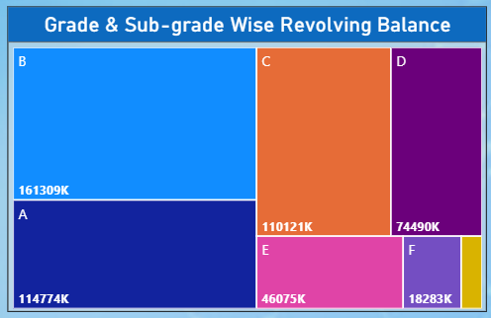

KPI 2 [GRADE AND SUBGRADE WISE LOAN]

Slide 10
KPI 2 ANALYSIS
The highest revolving balance is associated with Grade B, which indicates that customers with B grade tend to have higher credit utilization and potentially higher incomes, as they are able to maintain such a substantial balance.
The customers of Grade A and Grade C might be using their credit cards for regular expenses but not to an excessive degree. So they are at the middle in terms of credit utilization.
Customers with Grade D and E maintains a slightly lower credit utilization, possibly due to a low spending or lower incomes.
Group F and Group G might comprise customers who rarely use their credit cards or only for emergencies.

Slide 11
IMPROVEMENT POINTS
Engage with customers in grades F and G to understand their concerns or reasons for lower utilization. This feedback can guide improvements to your services and potentially increase their engagement.
Consider introducing incentive programs for grades D,E,F and G to encourage increased utilization. This could include special offers, rewards, or benefits tied to higher utilization levels.
Provide educational resources to customers across all grades on how to effectively utilize revolving credit, manage debt, and maximize the benefits of your services.

Slide 12
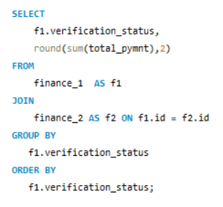
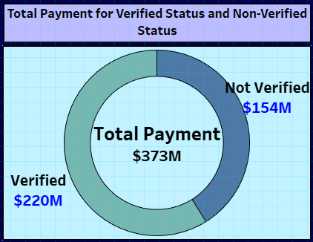
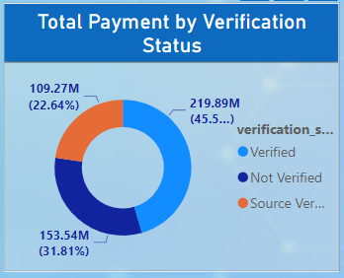
KPI 3 [Total Payment for Verified Status Vs Non Verified Status]

Slide 13
KPI 3 ANALYSIS
This graph shows that verified payment is more compared to the non-verified payment which minimizing fraudulent or unauthorized transactions.
As we can see there are some non-verified payment which indicates there are some issues in the verification process, leading to missed opportunities for revenue.

Slide 14
IMPROVEMENT POINTS
Introduce some new advanced verification technologies, such as biometric authentication or AI-based identity verification, to reduce false negatives.
Educate users about the verification process, its importance, and the benefits of completing it to boost their confidence in the system.
Establish a feedback mechanism where users can provide insights about their verification experience, helping to refine the process.

Slide 15
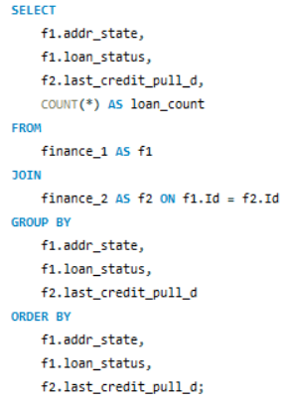
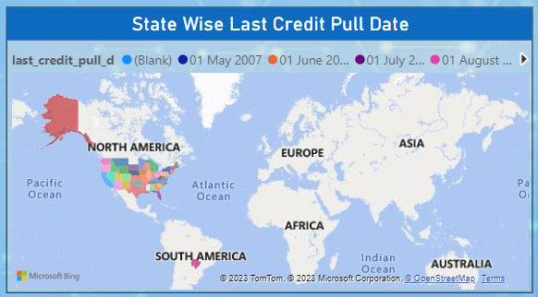
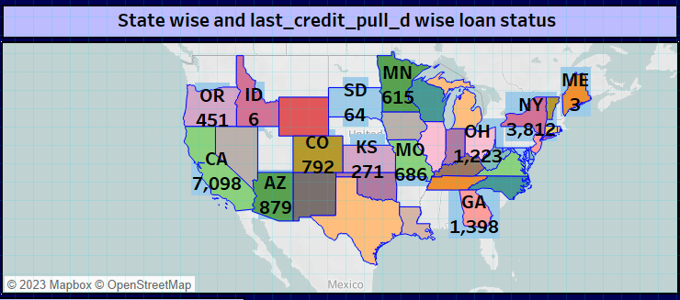
KPI 4 [State wise and last credit pull date wise loan status]

Slide 16
ANALYSIS OF KPI 4
As we seen in the graph lets segregate this report into 2 parts on the behalf of highest and lowest credit pull count state wise.
Top 5 state Buttom 5 state
States like CA,TX, NY and FL have notably high credit pull counts. This could be due to their larger populations, higher economic activities, and more frequent credit-related transactions.
Some states have relatively low credit pull counts, such as IA,ME,NE and TN. This might be due to various reasons, including smaller populations, lower credit utilization, or fewer credit-related transactions.
State | count
CA | 7097
NY | 3812
FL | 2866
TX | 2727
GA | 1398
State | count
ME | 3
IA | 5
NE | 5
TN | 17
MS | 19

Slide 17
IMPROVEMENT POINTS
To increase the credit pull counts public awarness is the important factor and following action should be needed to improve this.
Organize workshops, seminars, and webinars on credit management, budgeting, and financial planning in partnership with local banks or credit unions.
Develop programs to assist individuals with poor or no credit history in building credit through responsible financial practices.
And the most important point to collaborate with data analytics experts to identify trends and patterns that could help target specific demographics for credit pull promotions.

Slide 18
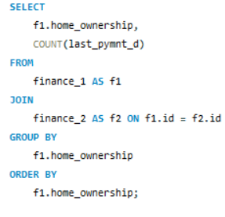
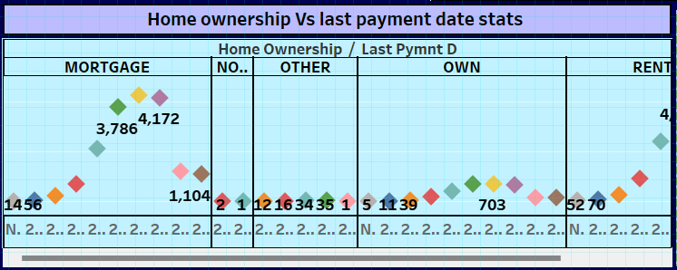
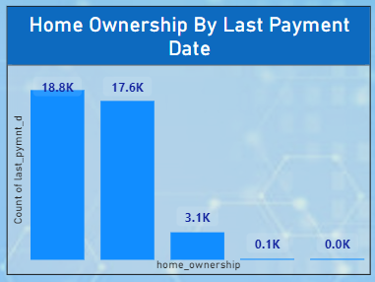
KPI 5 [Home ownership Vs last payment date stats]

Slide 19
KPI 5 ANALYSIS
It's indicate that the majority of loans are held by individuals with the "RENT" and "MORTGAGE" categories of home ownership. "NONE" and "OTHER" categories have significantly lower counts, while the "OWN" category falls in between.

Slide 20
IMPROVEMENT POINTS
As we have analyse about the highest payment count in Mortgage and Rent we should increase our marketing efforts to target specific home ownership categories. For example, if we want to encourage more people to take out mortgages, we could create targeted campaigns for individuals who currently rent or own their homes.
Depending on the distribution of home ownership types, you might want to tailor your loan products to cater to the needs of different groups. For example, if there are many renters, you could offer rent-to-own programs.
Consider partnering with real estate agents, property management companies, or other organizations in the housing industry to reach a wider audience and generate more leads.

Slide 21
THANK YOU

